Slide 1
Internet Control
Message Protocol

Slide 2
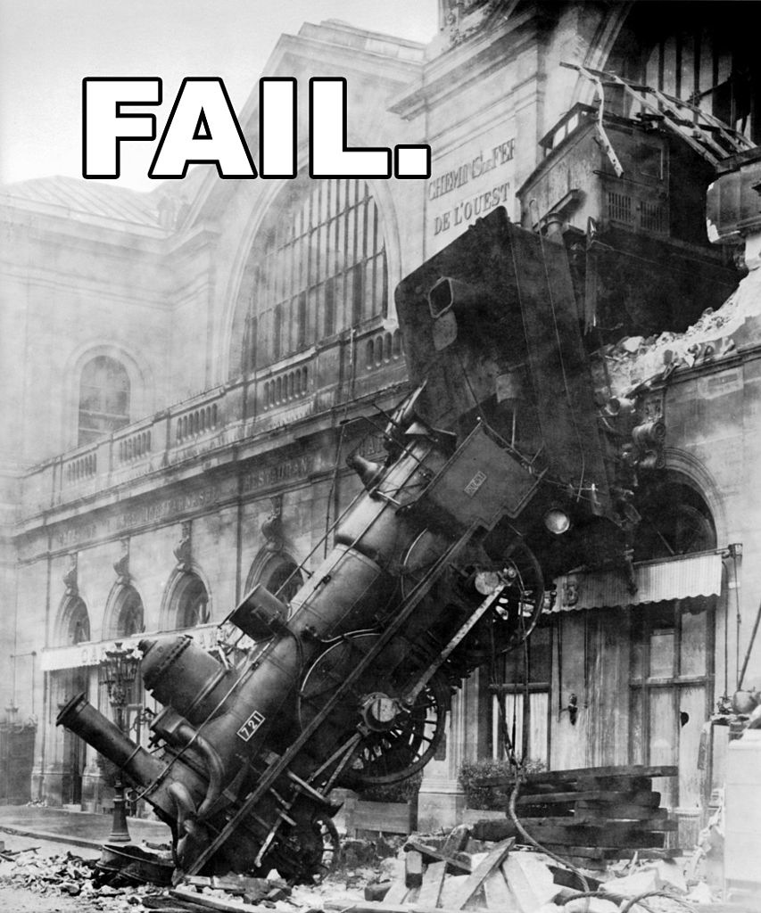

Purpose
Error messages
Queries
Configuration
Notes:
RFC792
TCP and UDP are for messages from one host to another. But there’s lots of error conditions [CLICK] where a router needs to talk to a host [CLICK],
or where a host needs to ask questions of a router [CLICK]
or where two routers need to talk to each other [CLICK]
So, not long after the Internet itself was invented, ICMP—the Internet Control Message Protocol—was invented.

Slide 3

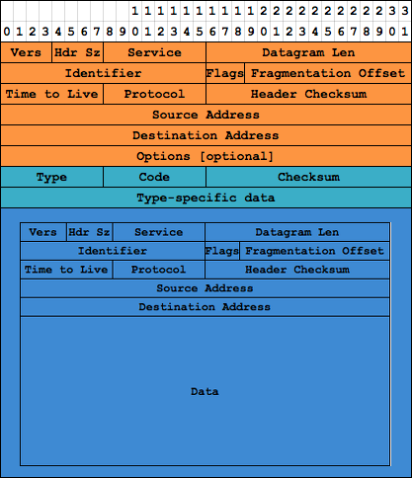
Message Format
Notes:
Simple packet format. It’s built on top of IP, of course, since that’s the only hammer the Internet has. There’s an 8-bit type code, an 8-bit reason or subtype code, a checksum, and then 32 bits for any additional info the packet needs. Then, since these are usually generated in response to errors, the IP header (the orange part) plus the first 8 bytes (this diagram’s not to scale; sorry about the error) of the original packet are included.

Slide 4
Message Types
Router Solicitation
Echo Reply
Timestamp Reply
Destination Unreachable
Source Quench
Information Request
Redirect
Router Advertisement
Echo Request
Address Mask Request
Alternate Host Address
Parameter Problem
Time Exceeded
Address Mask Reply
Timestamp
Traceroute
Information Reply
Notes:
Like everything else about TCP/IP, a lot of this are half-assed attempts at standards that have since been abandoned, or bad ideas that have been deprecated. [CLICK]

Slide 5
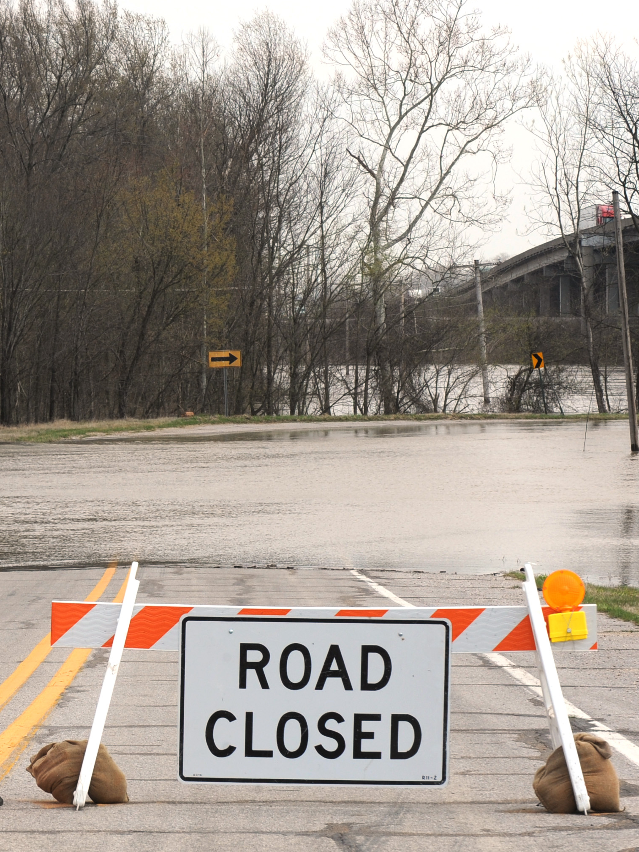
Destination Unreachable
WSAECONNREFUSED
WSAECONNRESET
WSAEHOSTUNREACH
WSAENETUNREACH
Fragmentation
Notes:
port unreachable = WSAECONNREFUSED or WSAECONNRESET
host unreachable = WSAEHOSTUNREACH or WSAENETUNREACH
fragmentation needed and DF set = ???

Slide 6
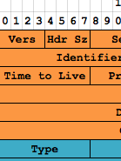
Time Exceeded
TTL and traceroute
Notes:
remember the TTL bit? This gets sent when packets die of old age. Also if a packet is fragmented and some of the fragments get lost.
This is also how trace route works [explain]

Slide 7

Redirect
Internal Use Only
Notes:
Basically a way for one router to tell another “there’s a better router for you to be sending that to”. But you know how in a heist movie, they’ll put up the fake road construction signs to send the armored car over to where the guy with the rocket launcher is? Yeah.

Slide 8
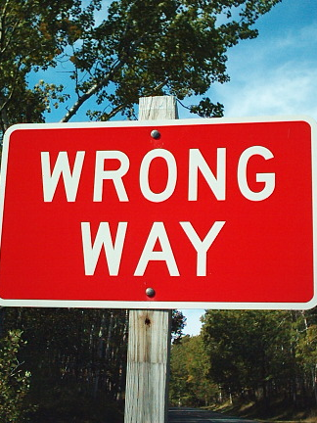
Parameter Problem
WSAENOPROTOOPT
Notes:
This is usually the result of a corrupted packet; most TCP stacks won’t let you send out packets with bad options.

Slide 9

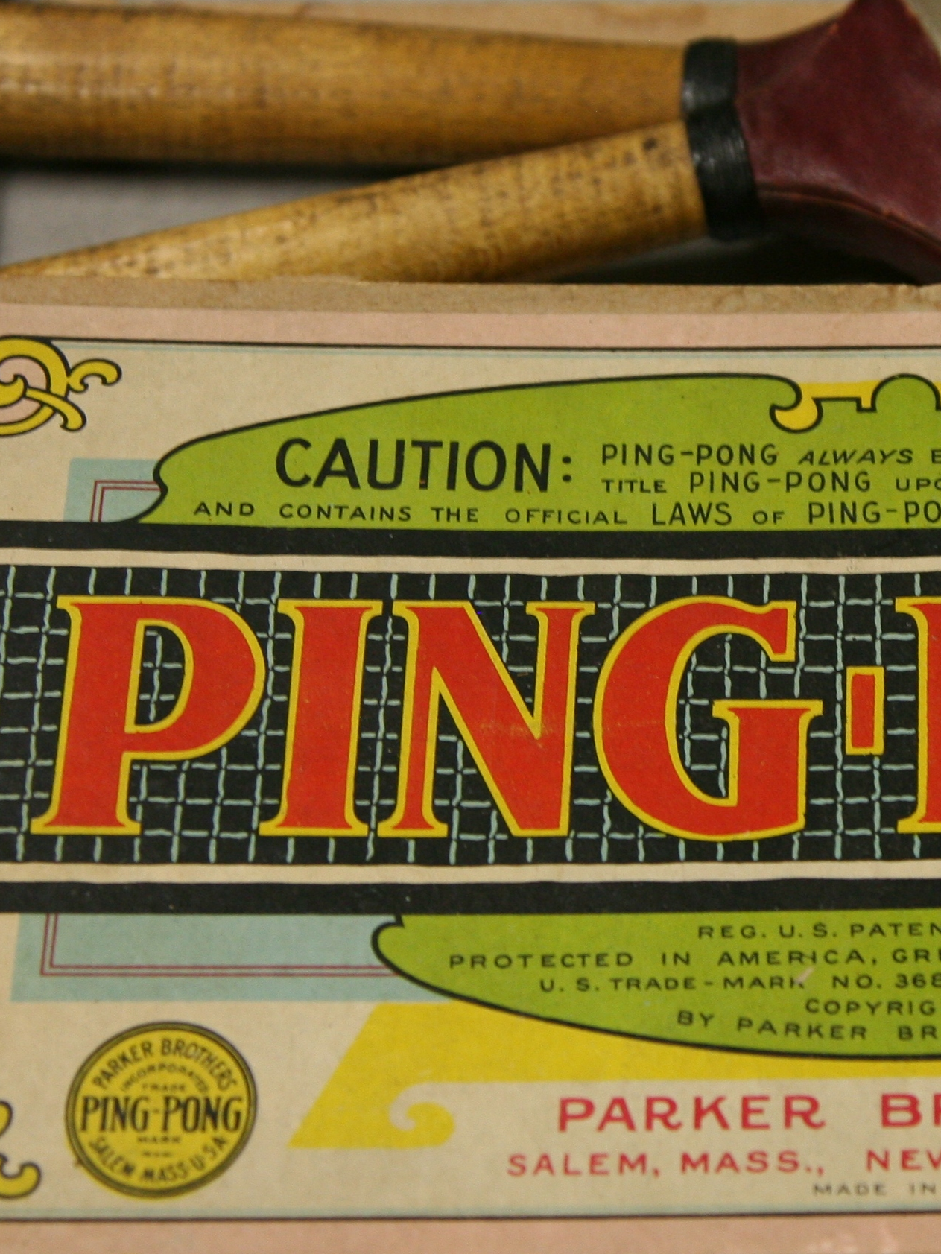

Echo Request Echo Reply
Internal Use Only
Notes:
A host sends out a message saying “hey, send me back a message containing this exact same data”.
Who can see a way to abuse this? Well, let me tell you a story about IP broadcast addresses…
[CLICK for smurf]
Here’s another fun one. A host can send out one of these ICMP packets containing any data… and they’re not TCP or UDP, so they’re not examined by firewalls. They’re also not generally blocked by firewalls. So, let’s suppose you get a key logger on someone’s computer, but you need some way to send the log traffic back to your collection server…

Slide 10

Router Advertisement
& Solicitation
Notes:
Supplements the routing protocols—basically lets routers find each other so that they then know to ask each other for routing tables

Slide 11
Bottom Line
The Internet Control Message Protocol allows routers and hosts to talk to each other “out of band”
Some error conditions result in ICMP messages; some ICMP messages result in application-level error messages
Very often blocked due to security issues

